Slide 1
SECURItiZATION
CONFIDENTIAL
C1
Use case: Paris Titrisation
MICKAEL MOESON

Slide 2
What is securitization
Securitization is the process of taking an illiquid asset, or group of assets, and through financial engineering, transforming them into a security. It is an alternate financing solution for the corporates (vs regular loans).
Antalis 2/3 application is handling Securitization of short term assets such as receivables. Funding is usually done through asset backed commercial paper (ABCP)
Long Term assets securitization: funding has a long maturity (over a year), usually through bonds or credit linked notes. Asset classes are:
    ABS (Asset Backed Securities): assets can be credit card receivables, consumer loans, auto loans, lease receivables, aircraft, whole business etc.
    CDO (Collateralised Debt Obligations): assets being pools of corporate/sovereign loans and bonds.
    CMBS (Commercial Mortgaged Backed Securities): commercial real estate financing, i.e. office, mall, hotel.
    RMBS (Residential Mortgage Backed Securities).

Slide 3
Securitization theoretical schema
SECURITIZATION PRINCIPLES SCHEMA
Receivable purchase
Loan / Deposit
Seller
Issuing SPV
Investors
Loan / Deposit refunding
Receivable repayment
Debt reimbursement
Debt reimbursement
Debtors

Slide 4
Securitization Benefits
On a seller point of view
Liquidity/financing
  Cash available immediately thanks to the asset transfer
  Low cost resources
  Low volatility of the issued products
Asset & Liability management
  Risk management
  Prudential ratio management
Strategic
  Diversify the financing model
On an investor point of view
Asset class diversification
Risk management (rating stability of the SPV)

Slide 5





Securitization at sg
Credit enhancement
Sale of receivables and collection
Intermediary SPV
Seller
Subscription of notes
Purchase of receivables
Repayment of notes
SGCMF
Sale of receivables and collection
Purchase of receivables
Liquidity line
-Credit enhancement-
Credit-link deposit
Interco Loan-Guarantee
FX hedging
Obligor 1
Obligor 2
Obligor 2
A1/P1 USCP
In USD
A1/P1 ECP/BT
In EUR GBP USD CHF
Obligor n

Slide 6
Paris titrisation activities
Paris Titrisation is a Societe General’s subsidiary acting as a managing company of French securitization funds.
Its role is to handle the SPV management, to calculate the cash flows and the tranching of the issuance to perform, to report to the regulator and to the other stakeholders on the operations…
Paris Titirsation is involved into securitization deals where funding could be handled by Antalis (Societe General’s funding conduit) or not.
Before Paris Titrisation segregation project, Paris Titrisation deals were managed in two different ways :
  Deals funded through Antalis conduit – they were managed in Antalis 3 application. This application was used for all securitization deals funded through Antalis including a Paris Titrisation FCT or not,
  Deals not funded through Antalis conduit – they were managed through Excel spreadsheet outside of any application.
Following Paris Titrisation Agreement to become a SGP (“Société de gestion de portefeuilles”) in july 2014, a segregation has been implemented within the team:
  3 Deal managers were dedicated to deals with Paris Titrisation FCT,
  The other Deal managers would manage deals without Paris Titrisation FCT.
The aims of this IT project were :
  To centralize in one application all Paris Titrisation FCT,
  To implement in the application the activity segregation already in place within the team.

Slide 7
Paris titrisation project
The aims of this IT project were :
  To centralize in one application all Paris Titrisation FCT,
  To implement in the application the activity segregation already in place within the team.
The segregation was made by:
  Renaming Antalis3 to Securitization tool (Sectool) to prevent any confusion between the funding conduit and the management entity
  The deals funded by Antalis remain managed in the existing modules interlocked in the current processes,
  A new module is created in a web platform, to manage Paris Titrisation deals. Deal features and calculations rules are managed through Aposed Spreadsheets,
  A transversal dashboard is created to report information on Paris Titrisation whatever the module the deals are managed in,
  Data and Process segregation implemented through access security profiles
Sectool Application Owner : Cannelle BARRIER – OPER/FIN/CMF/SEC
Sectool Application Manager : Fella ZALEGH – ITEC/FCC/OSD/SCM

Slide 8
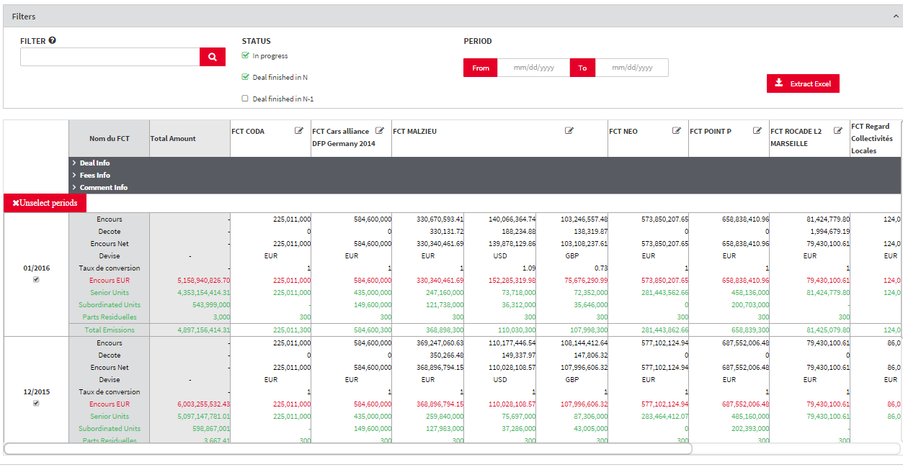
SECTOOL WEB - PARIS Titrisation Dashboard
Accessible only to Paris Titrisation users:
  It provides a consolidated vision on all deals within Paris Titrisation perimeter,
  Content is reported regardless to the way the deals are funded (through Antalis conduit or not).

Slide 9
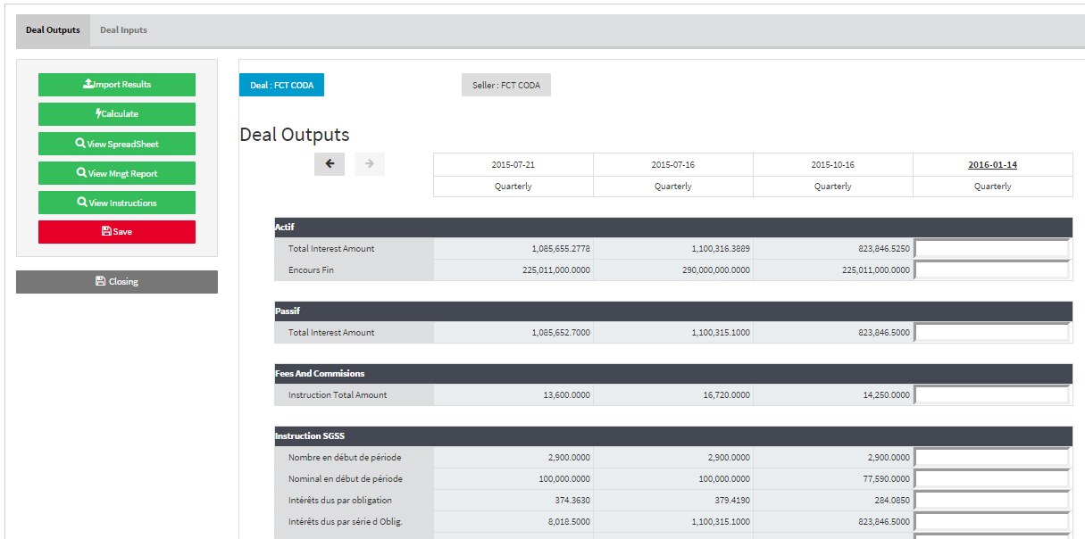
SECTOOL WEB - PARIS Titrisation DEAL MANAGEMENT
Deal Management Screen:
  Information of PTI deals that are not funded with Antalis conduit are displayed on this screen. Users can calculate information, generate Instructions and Mgt Report,
  All management processes of the PTI deals not funded by Antalis conduit are performed on this screen.

Slide 10
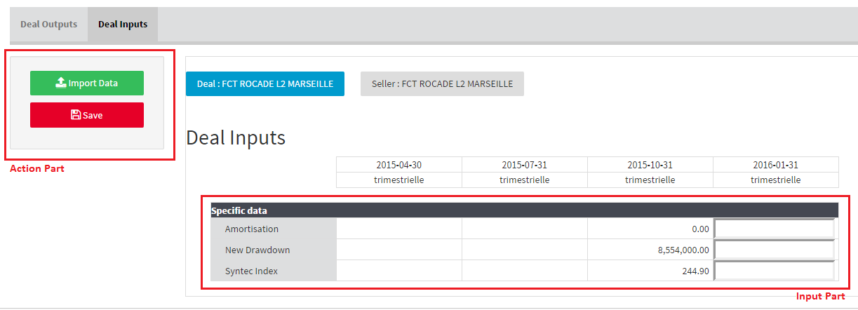

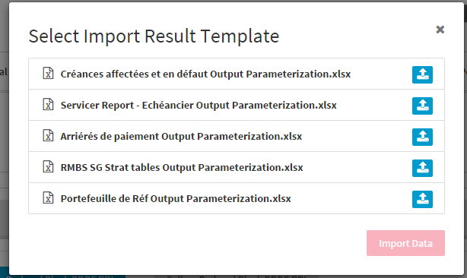
SECTOOL WEB - Deal Manager Input Screen
Input data:
To perform a calculation on a spreadsheet input data are needed. In Sectool those information are added through the seller report screen. In Sectool Web they are set up in this section. There are 2 ways to do this. Manually or by importing data from XL files.
Save Button
This action persists information on screen in database whether
they are manually or automatically filled up. Then they will be used as basis
by the calculation spreadsheet.
Import Data
This button allows users to load input information needed from a
Excel document. Once the button clicked, a popup appears with the list of
available document to import. It would be possible to upload one or more
of the list.

Slide 11
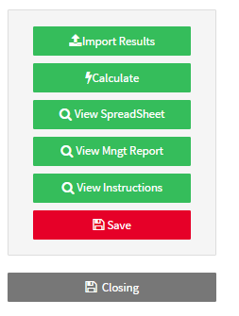
SECTOOL WEB - Deal Manager Output ScreeN
Import Result:
In the same way as in Sectool, this action allows user to import a pre defined kind of document that contains information considered as result. These data would update output information on screen.
Calculate:
Prerequisite: All input data needed for calculation, have to be filled in the “Deal Inputs” part (detailed further).
This operation loads input data in the spreadsheet, launches a calculation and displays the result on screen.
Depending of the parameterization, the calculation process can update all or just a part of the screen.
View Spreadsheet:
Prerequisite : A calculation has to be done successfully before.
In the same way as in Sectool, this action allow user to open and see the calculation spreadsheet fulfilled with data.
View Instructions:
Like “View Spreadsheet” this action is available after a successful calculation. It’s a new feature that allows users to generate and see the instructions that would be sent to other stakeholders of the deal (funds, sgss, etc…).
Save:
This button save data displayed on screen into the database.
Closing:
In the same way as in Sectool, this action allow user to close the current period and open the next one according to the calendar setup.
Once a period is closed:
Data displayed on Deal Outputs screen become non-editable
The Closing button become disable.

Slide 12
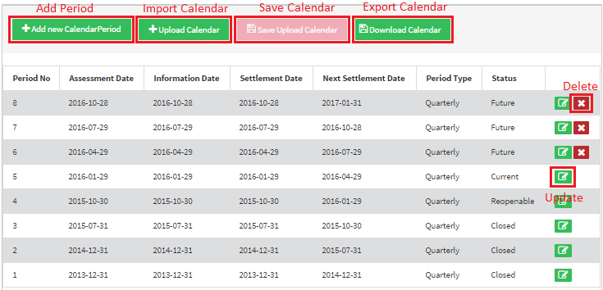
SECTOOL WEB – calendar management
Paris Titrisation a new calendar interface has been created to manage calculation periods:
This screen concerned only calendar of deal managed by Paris Titrisation but not funded through Antalis conduit.
Main dates are placed and defined on it : Assessment date, information date, Settlement date, Next Settlement date
The following features are available:
  Add a new Period
  Delete a Future Period
  Update a Period
  Import And Export a calendar

